Slide 1

HOLIDAY TRIP MANAGEMENT SYSTEM
Harman C++ Batch 6
presented by
Gnanesh K S
Aishwarya Das Prakash
Apoorva Devi M
Gayatri
Shaunak

Slide 2
CONTENTS
Introduction
Concepts Used
Software Requirements
Outline of the Project
Screenshots

Slide 3
INTRODUCTION
Holiday Trip Management System is a console based application which will help people to do hassle free choosing of a holiday package, flight tickets booking, accommodation services. This application is designed for the customers to get a good journey and get good memories and to make their journey hassle free.

Slide 4
CONCEPTS USED
Object Oriented Programming using C++
Database Management System

Slide 5
SOFTWARE REQUIREMENTS
Operating System: Windows
IDE: Code Blocks
Web Server used: Xampp (MySQL database)
Compiler: GCC

Slide 6
OUTLINE OF THE PROJECT
Step 1: Using GCC compiler , compile the code and run it.
Step 2: Create the database in xampp server.
Step 3: To create database connection import sql file.
Step 4: In code blocks open the .cpp file and run the code.

Slide 7
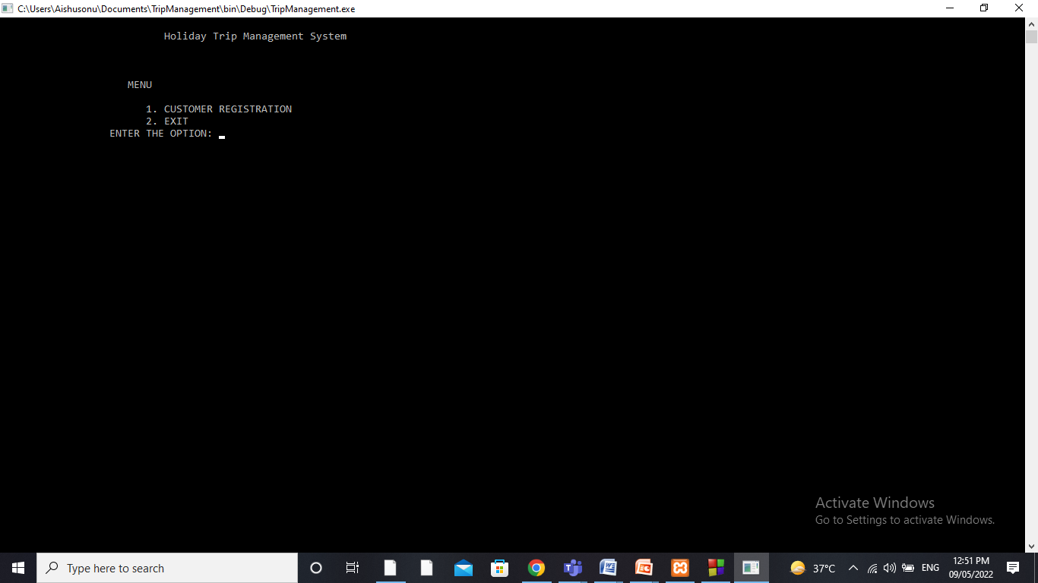
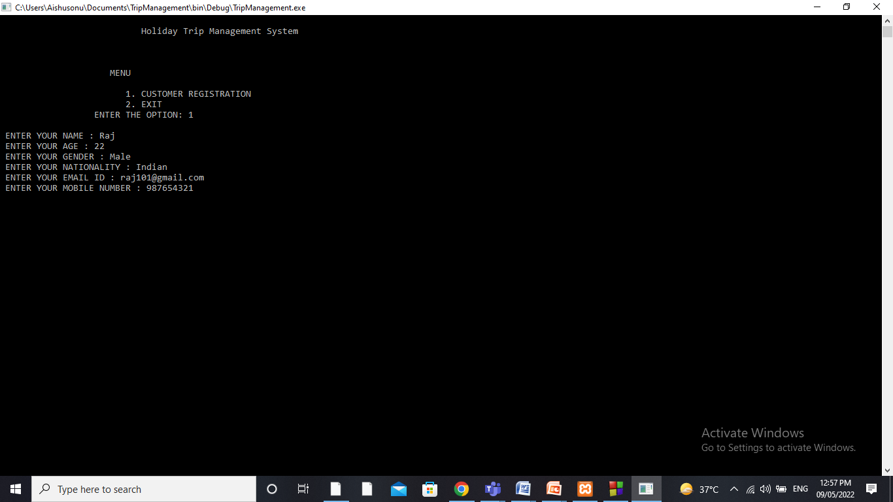
SCREENSHOTS

Slide 8
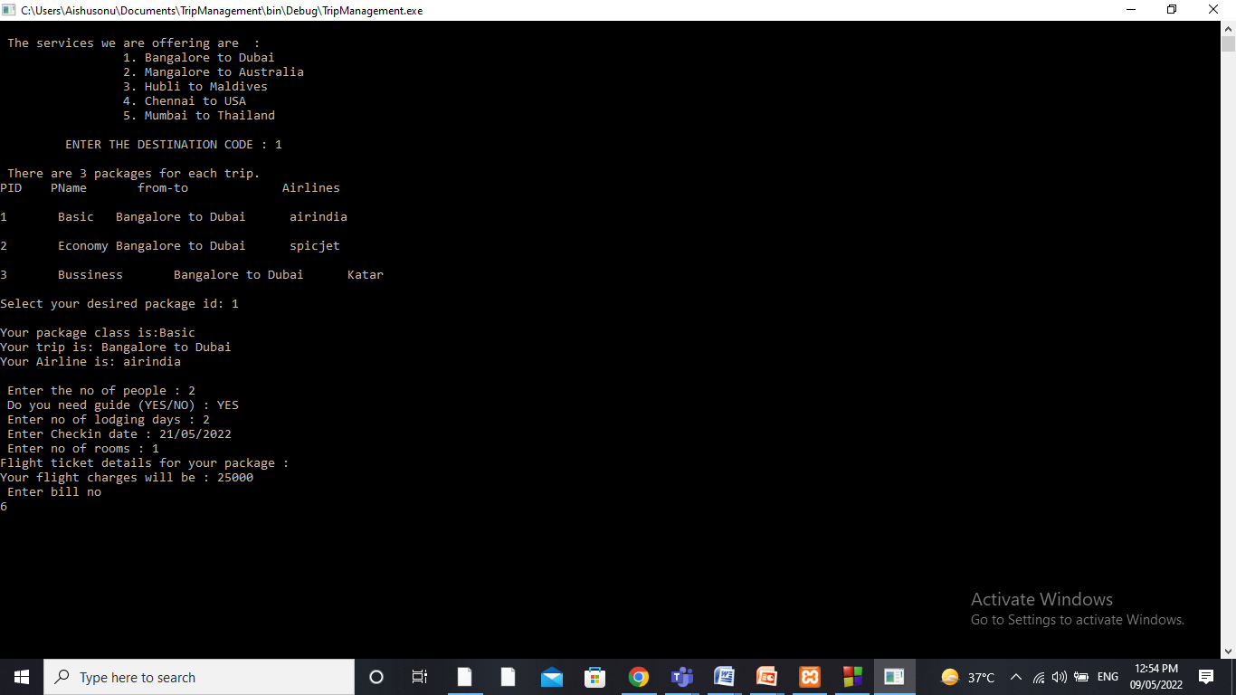


Slide 9
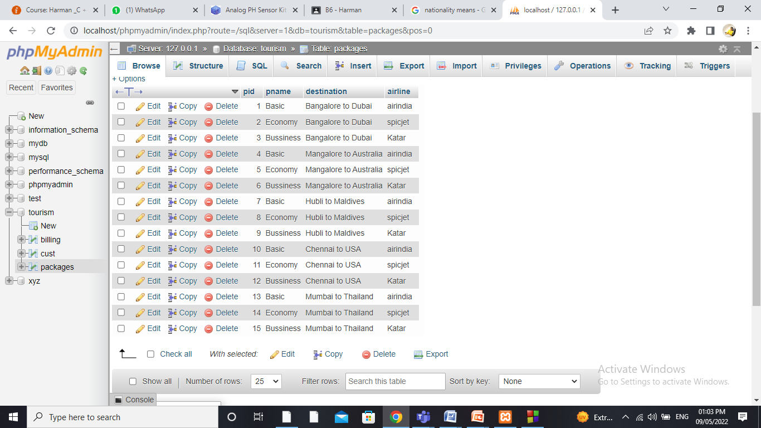

Slide 10
Thank you

